Slide 1
John 5.31-47
Testimony for Jesus

Slide 2
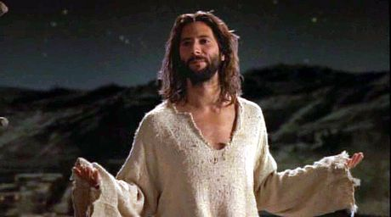
John 5.31-32 [NET]: “If I testify about myself, my testimony is not true. There is another who testifies about me, and I know the testimony he testifies about me is true.”

Slide 3
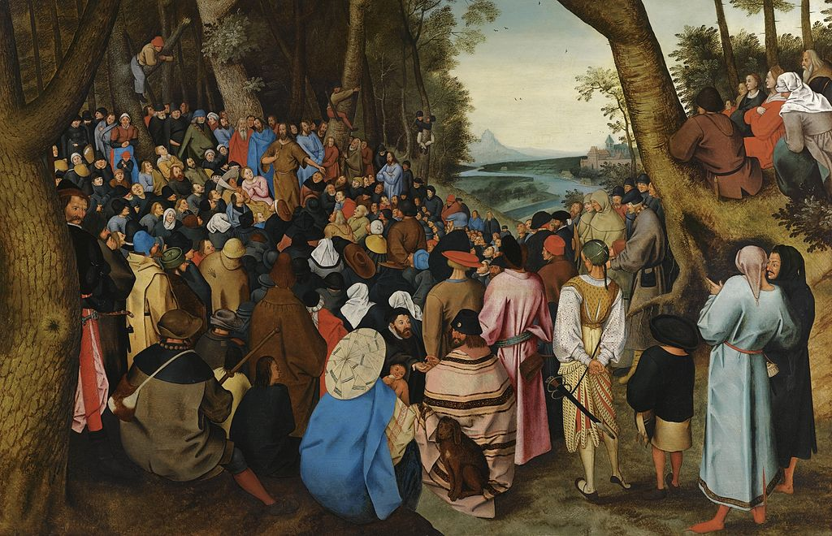
Painting of John the Baptist by Pieter Brueghel the Younger
John 5.33-35: “You have sent to John, and he has testified to the truth. (I do not accept human testimony, but I say this so that you may be saved.) He was a lamp that was burning and shining, and you wanted to rejoice greatly for a short time in his light.”

Slide 4
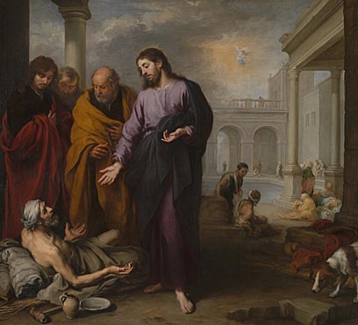
Jesus healing the disabled man at the pool
Bartolomé Esteban Murillo; nationalgallery.org.uk
John 5.36:
“But I have a testimony greater than that from John. For the deeds that the Father has assigned me to complete– the deeds I am now doing– testify about me that the Father has sent me.”

Slide 5
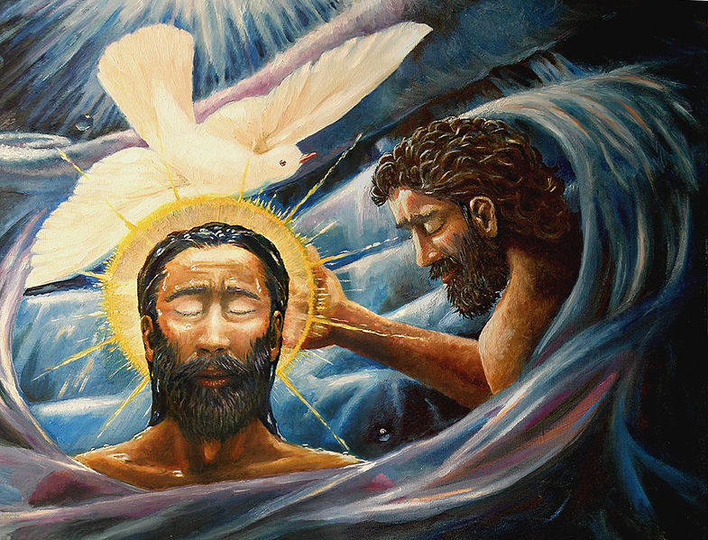
John 5.37-38: “And the Father who sent me has himself testified about me. You people have never heard his voice nor seen his form at any time, nor do you have his word residing in you, because you do not believe the one whom he sent.”
Painting of Jesus’ baptism by Davezelenka

Slide 6
Deuteronomy 18.15: The LORD your God will raise up for you a prophet like me from among you– from your fellow Israelites; you must listen to him.
Isaiah 9.6: For to us a child is born, to us a son is given, and the government will be on his shoulders. And he will be called Wonderful Counselor, Mighty God, Everlasting Father, Prince of Peace.
Psalm 2.12: Do homage to the Son, that He not become angry, and you perish in the way… How blessed are all who take refuge in Him!
John 5.39-40: “You study the scriptures thoroughly because you think in them you possess eternal life, and it is these same scriptures that testify about me, but you are not willing to come to me so that you may have life.”
Genesis 3.15: “... her offspring will attack your head, and you will attack her offspring's heel.”
Daniel 7.13-14: I was watching in the night visions, and with the clouds of the sky one like a son of man was approaching. He went up to the Ancient of Days and was escorted before him. To him was given ruling authority, honor, and sovereignty. All peoples, nations, and language groups were serving him. His authority is eternal and will not pass away. His kingdom will not be destroyed.

Slide 7
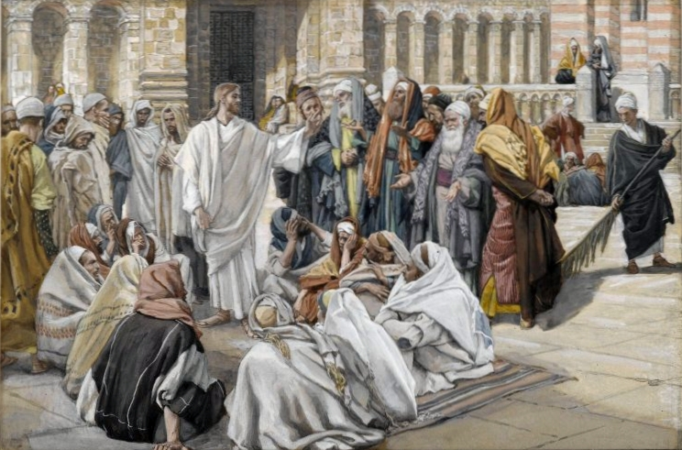
John 5.41-44: “I do not accept praise from people, but I know you, that you do not have the love of God within you. I have come in my Father's name, and you do not accept me. If someone else comes in his own name, you will accept him. How can you believe, if you accept praise from one another and don't seek the praise that comes from the only God?”
Jesus arguing with religious leaders
Painting by James Tissot
Displayed at brooklynmuseum.org

Slide 8
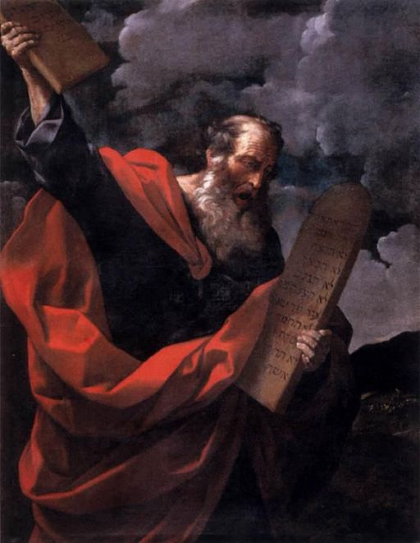
John 5.45-47: “Do not suppose that I will accuse you before the Father. The one who accuses you is Moses, in whom you have placed your hope. If you believed Moses, you would believe me, because he wrote about me. But if you do not believe what Moses wrote, how will you believe my words?”
Painting of Moses by Guido Reni
Displayed at Galleria Borghese

Slide 9
Divine Son of God come to earth as a man
Full revelation of God / wisest teacher
Creator
Ultimate Davidic King and Son of Man
God the Father’s anointed judge
Promised Messiah-Deliverer for Israel
Christ-Savior who offers spiritual life
God’s light / the sacrificial lamb
Bringer of Holy Spirit and New Covenant
Miracle worker / healer
Bridegroom of the Church
Center of worship
Jesus

Slide 10
… in Jesus’ identity
… in Jesus’ offer of salvation through his sacrifice on the cross
Believe
Salvation

Slide 11
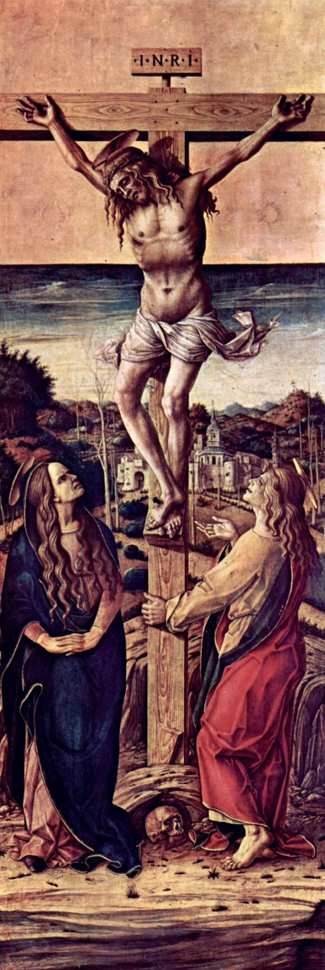
Believe…
in Jesus’ identity
Believe…
in Jesus’ offer of salvation through his sacrifice on the cross
Salvation
Painting by Carlo Crivelli
Displayed at Vanderbuilt University

